Slide 1

SoftUni memory game

Slide 2

Teodor Penev
Nicollette Karaivanova
Lyubomir Viktorov
Svilen Tyutyunev
Georgi Marinov

Slide 3
SoftUni memory – main game idea
You have 12 reversed cards
Flip one by one card till you find match
If it is not correct the 2 card flipover
Try to find all 6 trainers

Slide 4
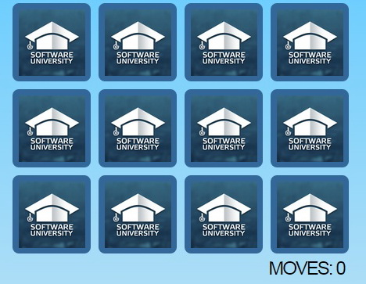
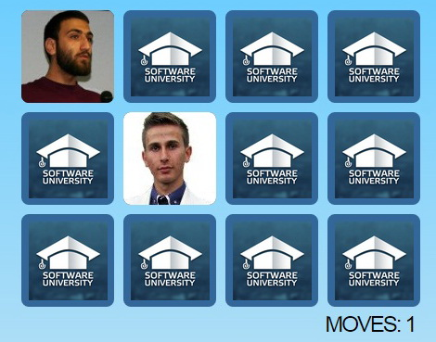
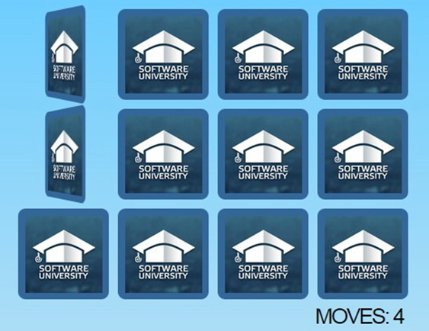
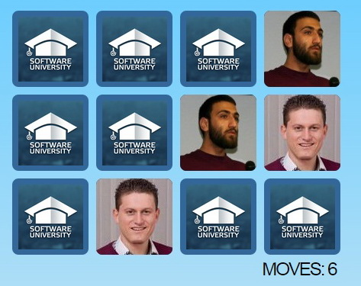
Demo

